Slide 1
Next Generation Sequencing
Wouter Bossuyt
Introduction to NGS sequencing
25/10/2023

Slide 4
DNA
RNA
Single cell genomics
Sequencing only
Direct Access
Bio-informatics

Slide 5
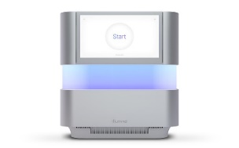
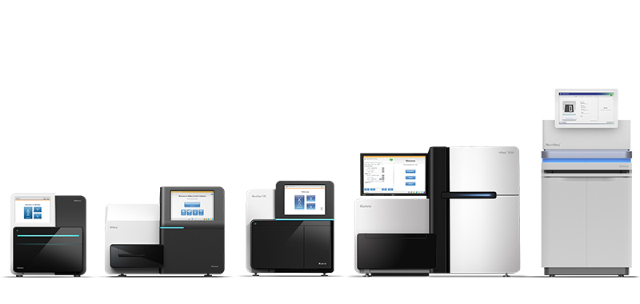
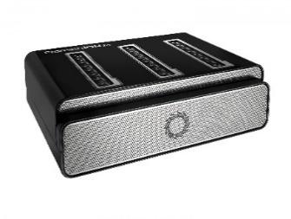
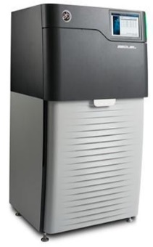
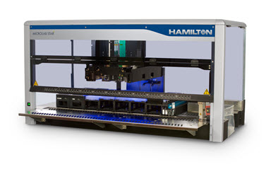
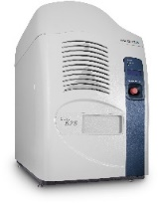
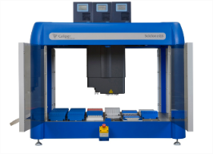
Our Team
22 people
Entire Illumina, Nanopore and Pacbio catalog

Slide 7
Sequencing: a history

Slide 8
Landmarks in DNA sequencing
1911:
Thomas Hunt Morgan disproves himself and find chromosomes as basis of hereditary
1944-1952
Avery–MacLeod–McCarty experiment (DNA in bacteria)
Hershey–Chase experiment (DNA in phages)
1953
Rosalind Franklin, Watson, Crick: Discovery of DNA double helix structure
Notes:
Thomas Hunt Morgan does not believe Mendel (after rediscovery in 1900) and Stutton-Boveri chromosome hypothesis. Wants to settle debate but finds mutations are present on chromosomes and develops genetic linkage (after Frans Alphonse Janssens, KUL, observes cross-over).
Fiers went for the RNA sequencing approach (bacteriophage MS2) but Sanger for DNA after initial failure on RNA. Sanger optimized fractionation used chain termination and won Nobel
Maxam-Gilbert: make different nucleotide specific abasic sites in P³²-DNA that are sensitive to cutting with Piperidine and electrophorese

Slide 9
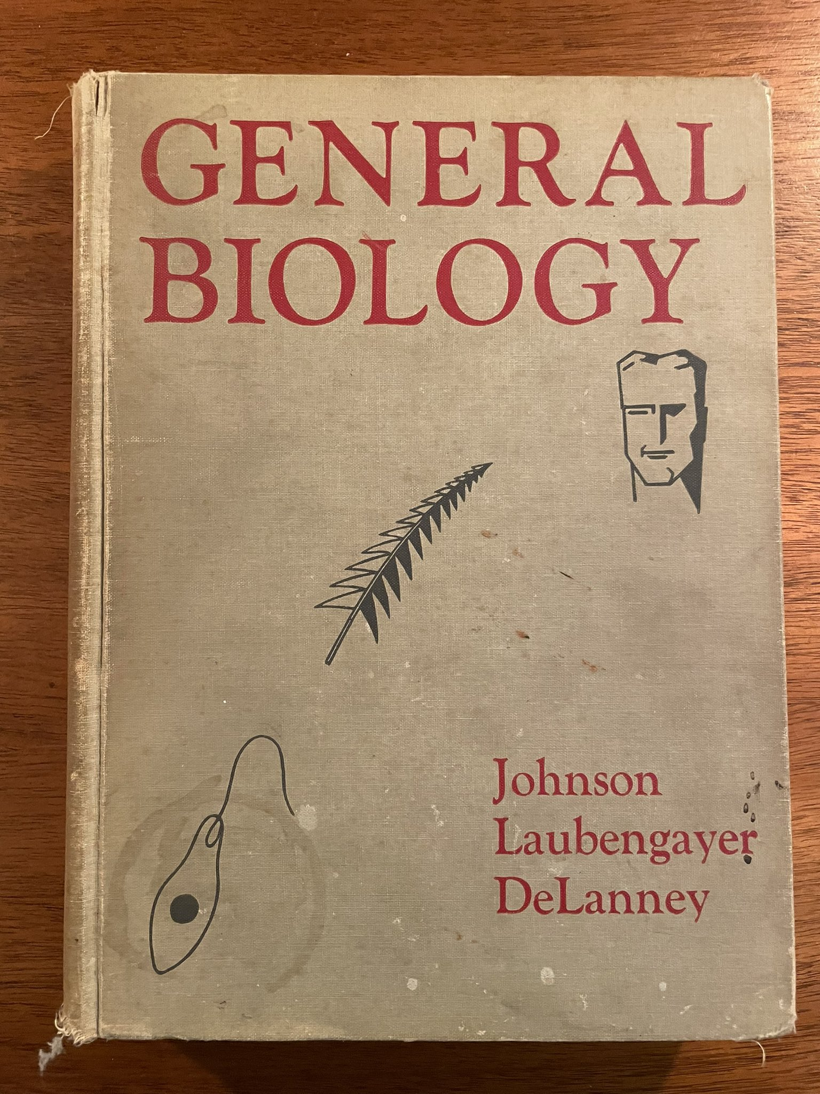
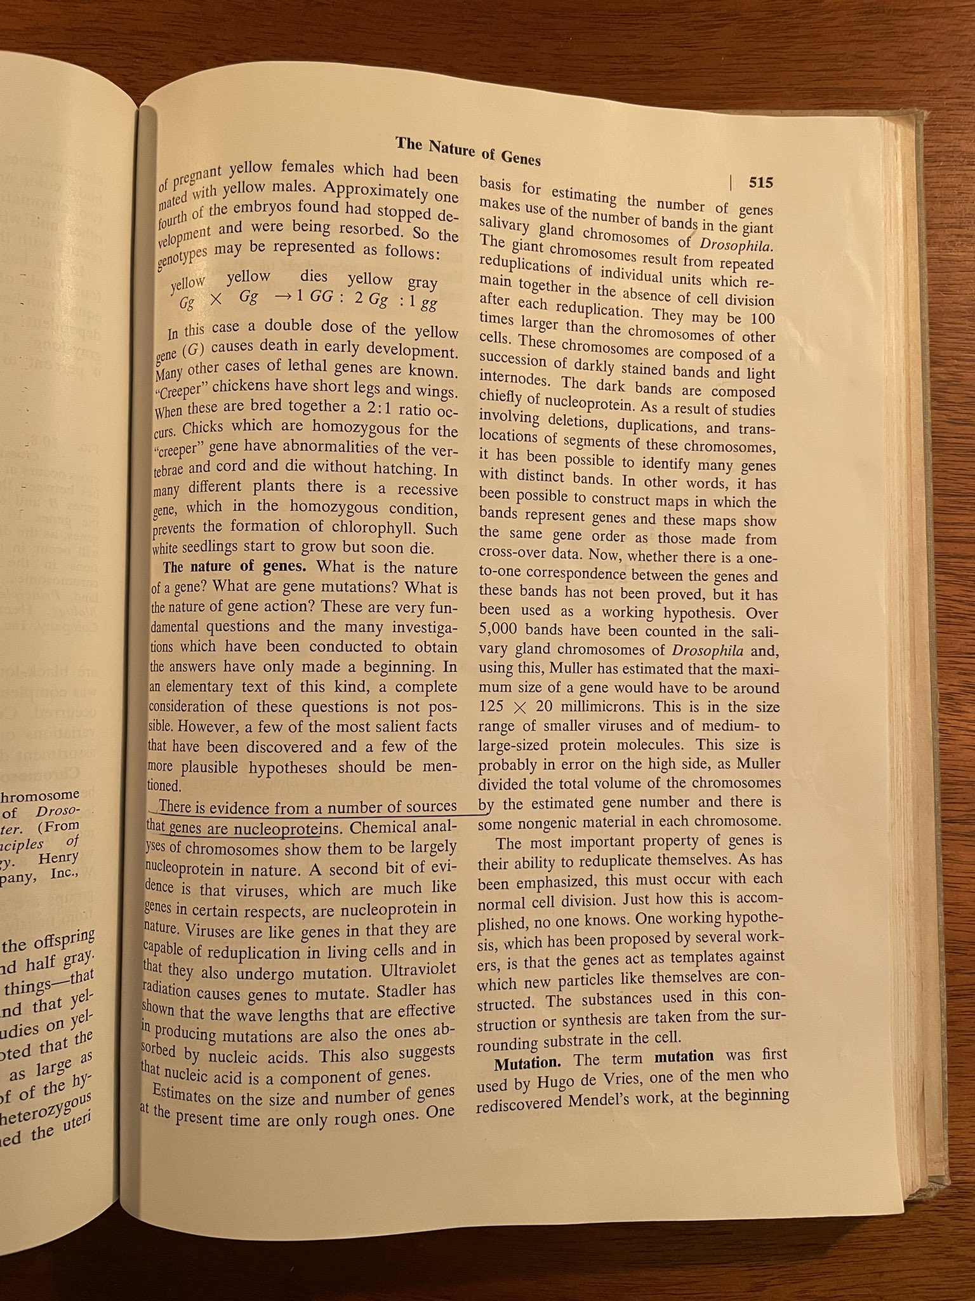
1956

Slide 10
Landmarks in DNA sequencing
1911:
Thomas Hunt Morgan disproves himself and find chromosomes as basis of hereditary
1944-1952
Avery–MacLeod–McCarty experiment (DNA in bacteria)
Hershey–Chase experiment (DNA in phages)
1953
Rosalind Franklin, Watson, Crick: Discovery of DNA double helix structure
1953-1977: the ‘desperate’ era
Walter Fiers use RNase digest in competition with Sanger
1977
A Maxam and W Gilbert "DNA seq by chemical degradation"
F Sanger"DNA sequencing with chain-terminating inhibitors"
Notes:
Thomas Hunt Morgan does not believe Mendel (after rediscovery in 1900) and Stutton-Boveri chromosome hypothesis. Wants to settle debate but finds mutations are present on chromosomes and develops genetic linkage (after Frans Alphonse Janssens, KUL, observes cross-over).
Fiers went for the RNA sequencing approach (bacteriophage MS2) but Sanger for DNA after initial failure on RNA. Sanger optimized fractionation used chain termination and won Nobel
Maxam-Gilbert: make different nucleotide specific abasic sites in P³²-DNA that are sensitive to cutting with Piperidine and electrophorese

Slide 11
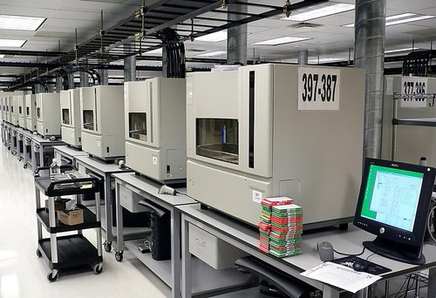
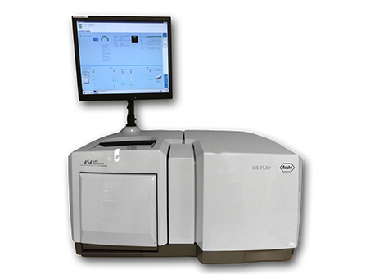
Landmarks in DNA sequencing
1984
DNA sequence of the Epstein-Barr virus, 172 kb
1987
Applied Biosystems - first automated sequencer
1991
Sequencing of human genome in Venter's lab
1996
P. Nyrén and M Ronaghi - pyrosequencing
2001
A draft sequence of the human genome
2003
human genome completed
2004
454 Life Sciences markets first NGS machine
Notes:
Thomas Hunt Morgan does not believe Mendel (after rediscovery in 1900). Wants to settle debate on but finds mutations are present on chromosomes and develops genetic linkage (after Frans Alphonse Janssens, KUL, observes cross-over).
Fiers went for the RNA sequencing approach (bacteriophage MS2) but Sanger for DNA after initial failure on RNA. Sanger optimized fractionation used chain termination and won Nobel
Maxam-Gilbert: make different nucleotide specific abasic sites in P³²-DNA that are sensitive to cutting with Piperidine and electrophorese

Slide 12
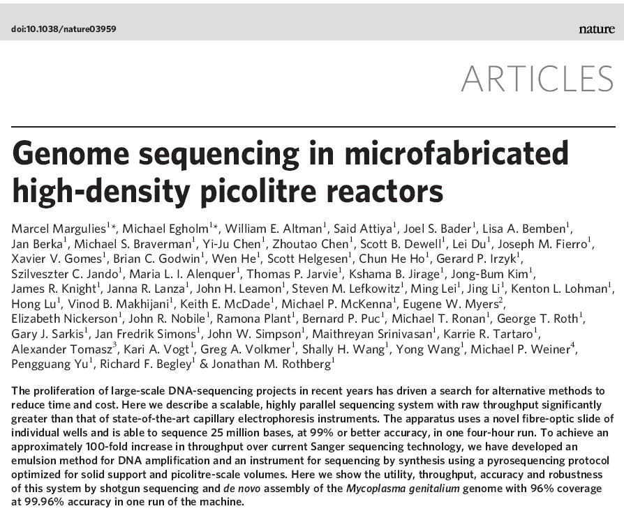
Notes:
2000 454 was founded
454 was the code name by which the project was referred to, at CuraGen
2005 publication technology
2007 acquired by Roche

Slide 13
DNA Sequencing – the next generation
NGS refers to non-Sanger-based high-throughput DNA sequencing technologies.
NGS technologies constitute various strategies that rely on a combination of
Library/template preparation
Parallel sequencing

Slide 14
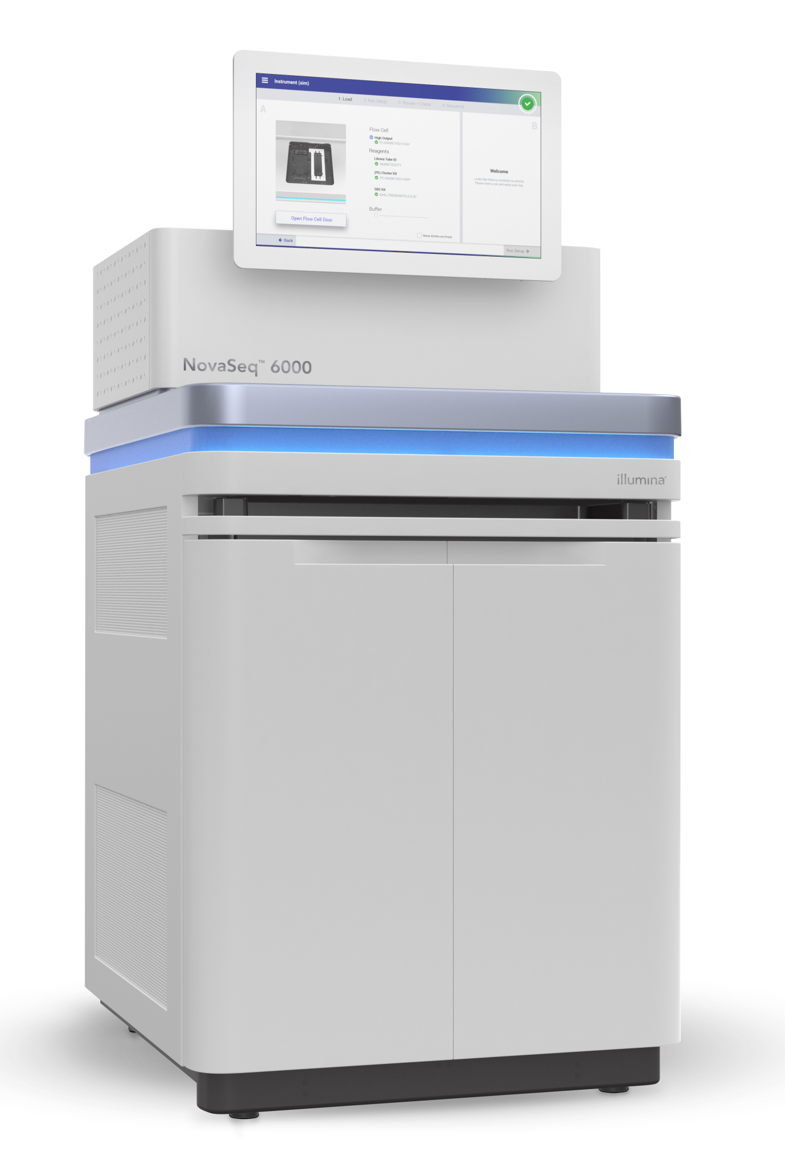
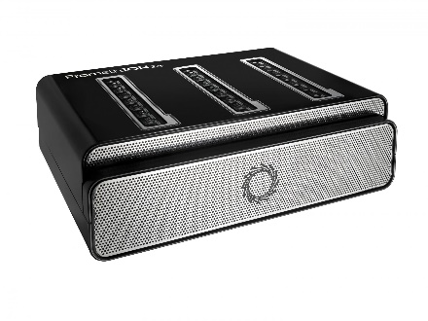
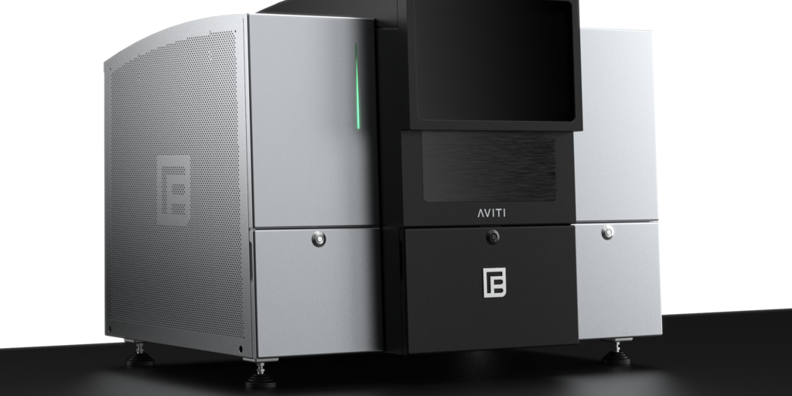
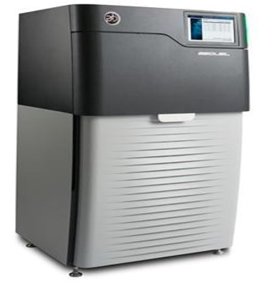
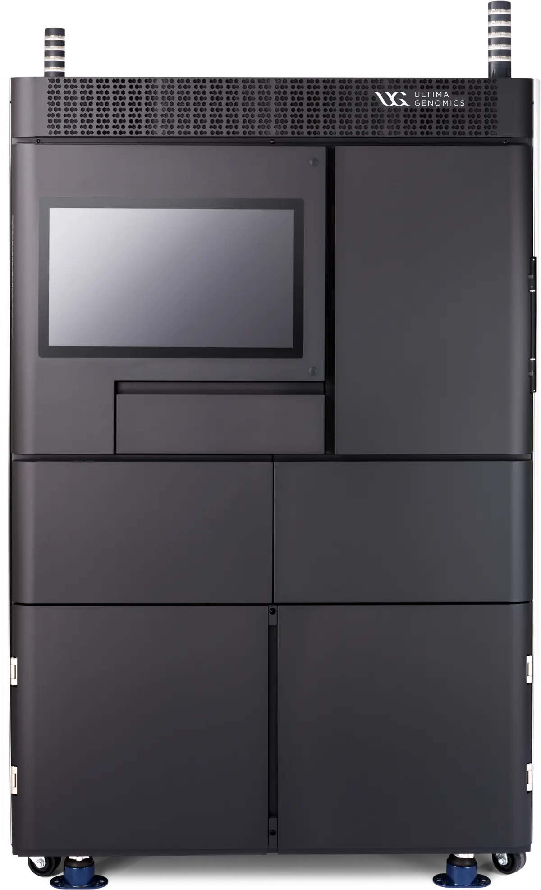
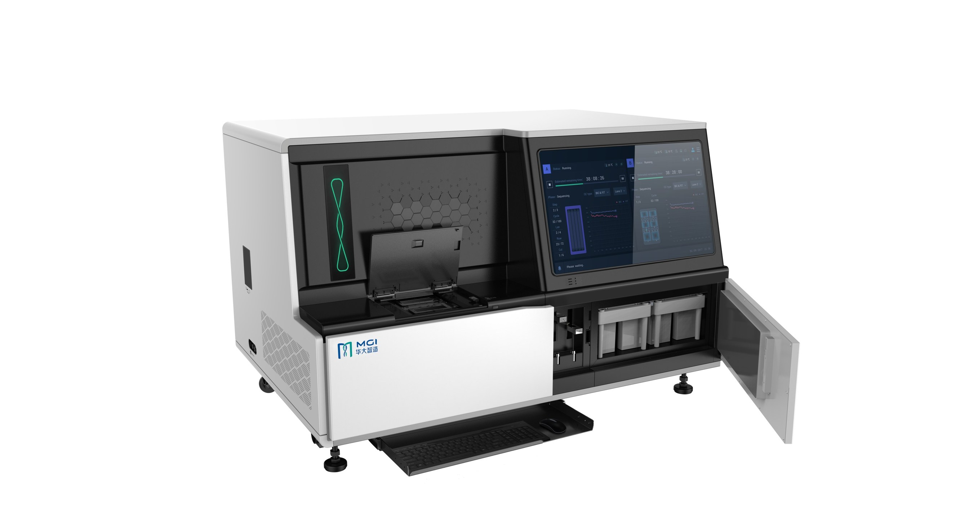
Different technologies
Illumina
AVITI Element
Nanopore
Illumina
Nanopore
Pacbio
MGI
AVITI Elements
Ultima
…
Pacbio
Ultima Genomics
MGI
List of NGS technologies and their specs:
https://docs.google.com/spreadsheets/d/1GMMfhyLK0-q8XkIo3YxlWaZA5vVMuhU1kg41g4xLkXc/edit?usp=sharing

Slide 15
Sequencing workflows

Slide 16
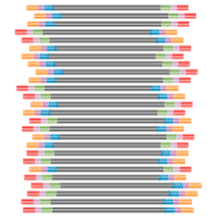
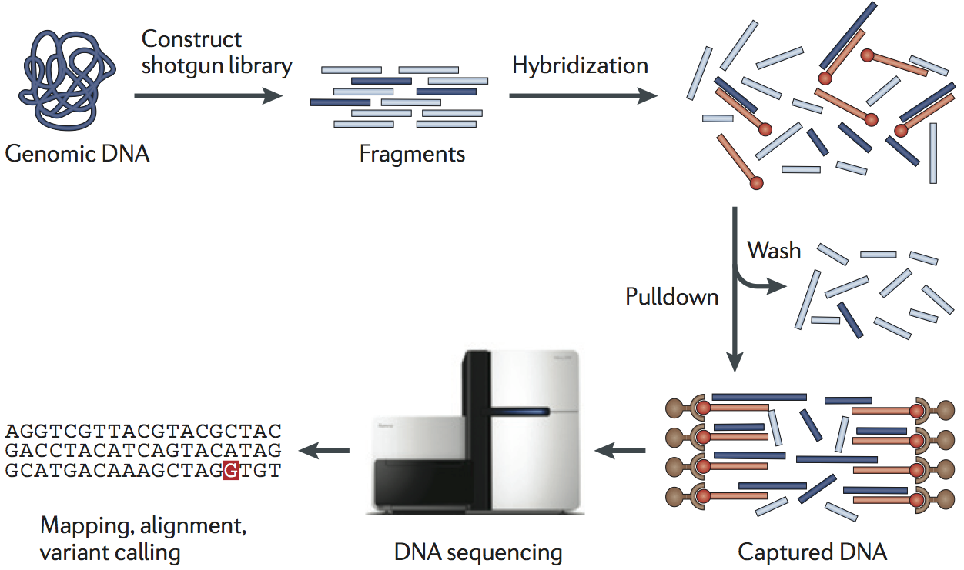

NGS workflow
Library
Variant filtering & interpretation

Slide 17
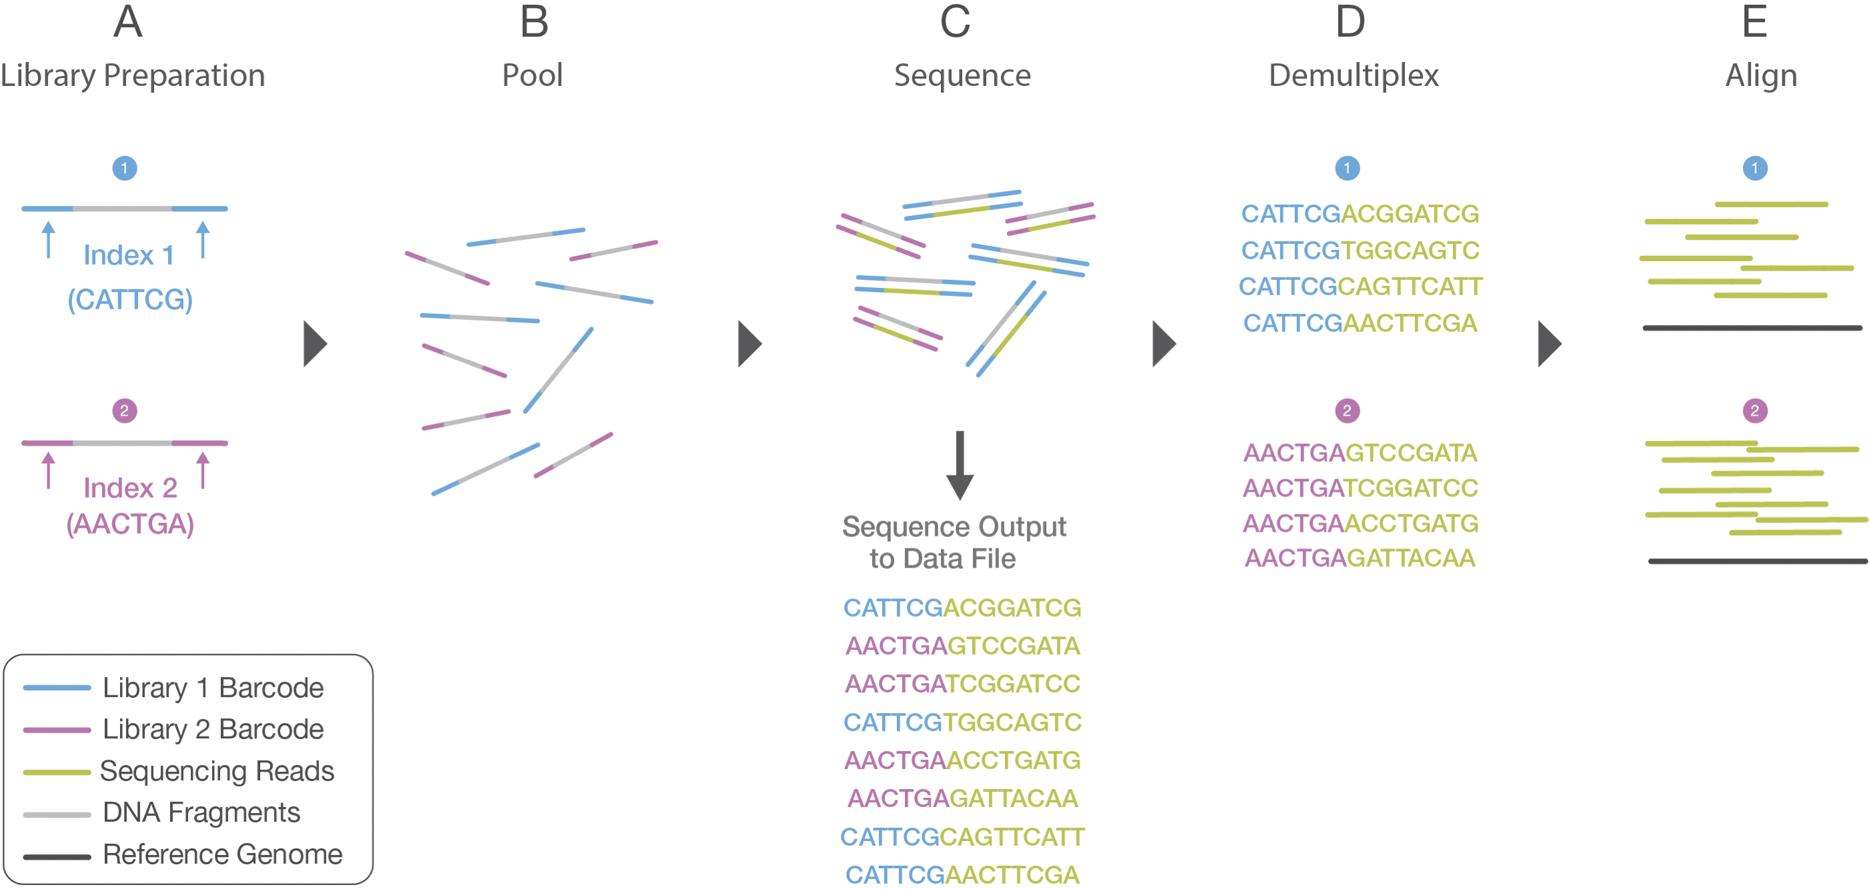
NGS Library Prep
Indexing
Sample barcodes
High diversity necessary
Unique dual indexing is top

Slide 18
NGS Library Prep
General DNA library prep
General RNA library prep
Targeted library prep approaches

Slide 19
NGS Library Prep
General DNA library prep
General RNA library prep
Targeted library prep approaches

Slide 20
NGS Library prep
Fragmentation
acoustic
covaris
enzymatic

Slide 21
NGS Library prep
Fragmentation
quality check: BioAnalyser / FragmentAnalyser

Slide 22
NGS Library prep
Standard A-tailing & adaptor-ligation (DNA/RNA)

Slide 23
NGS Library Prep
Illumina Nextera tagmentation
Transposon-based adapter insertion
PCR-based indexing

Slide 24
NGS Library Prep
General DNA library prep
General RNA library prep
Targeted library prep approaches

Slide 25
NGS Library Prep
General DNA library prep
General RNA library prep
Targeted library prep approaches

Slide 26
NGS Library Prep
Illumina TruSeq Stranded mRNA

Slide 27
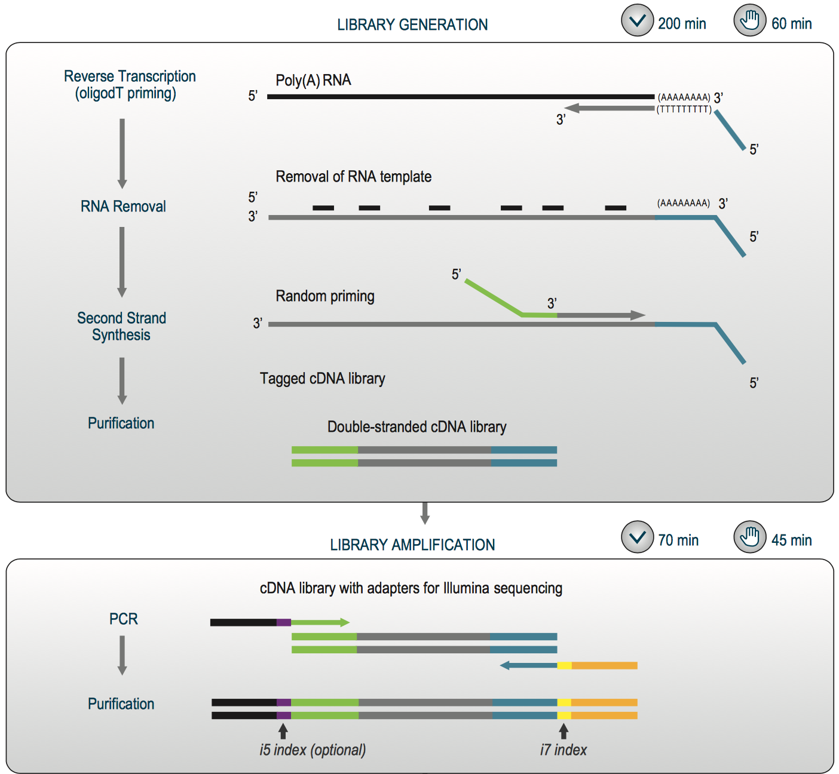
LexoGen QuantSeq (RNA)

Slide 28
NGS Library Prep
General DNA library prep
General RNA library prep
Targeted library prep approaches

Slide 29
NGS Library Prep
General DNA library prep
General RNA library prep
Targeted library prep approaches
amplicon based
ligation based
enrichment based

Slide 30
NGS Library Prep
Custom two step PCR
Performed by you
Performed by the GC

Slide 31
NGS Library Prep
MIPs
Multiplex probes
Hybridization and fill-in reaction
PCR linearization
PCR amplificaiton
Niedzicka et al. 2016

Slide 32
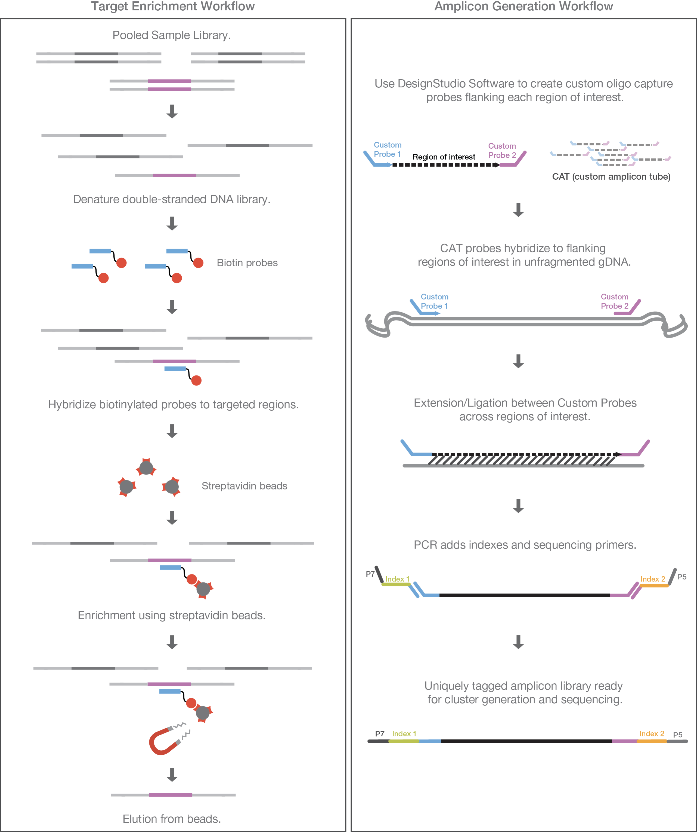
NGS Enrichment
Sequence capture

Slide 33
What do I chose? Long read, short read,…
 | Illumina | Nanopore | Pacbio
Read length | 35 bp to 600 bp | Anything goes | 250bp to 25kb (or 100kb)
Accuracy | High | Medium and improving | high
Capacity | Small to very large | Tiny to large | medium
Biases | Fragment size and GC |  | DNA modifications
Applications
WGS | +++ | ++ | +++
RNAseq | +++ | + | ++
Targeted resequencing | +++ | Only large fragments | ++
Single cell sequencing | +++

Slide 34
Illumina sequencing

Slide 35

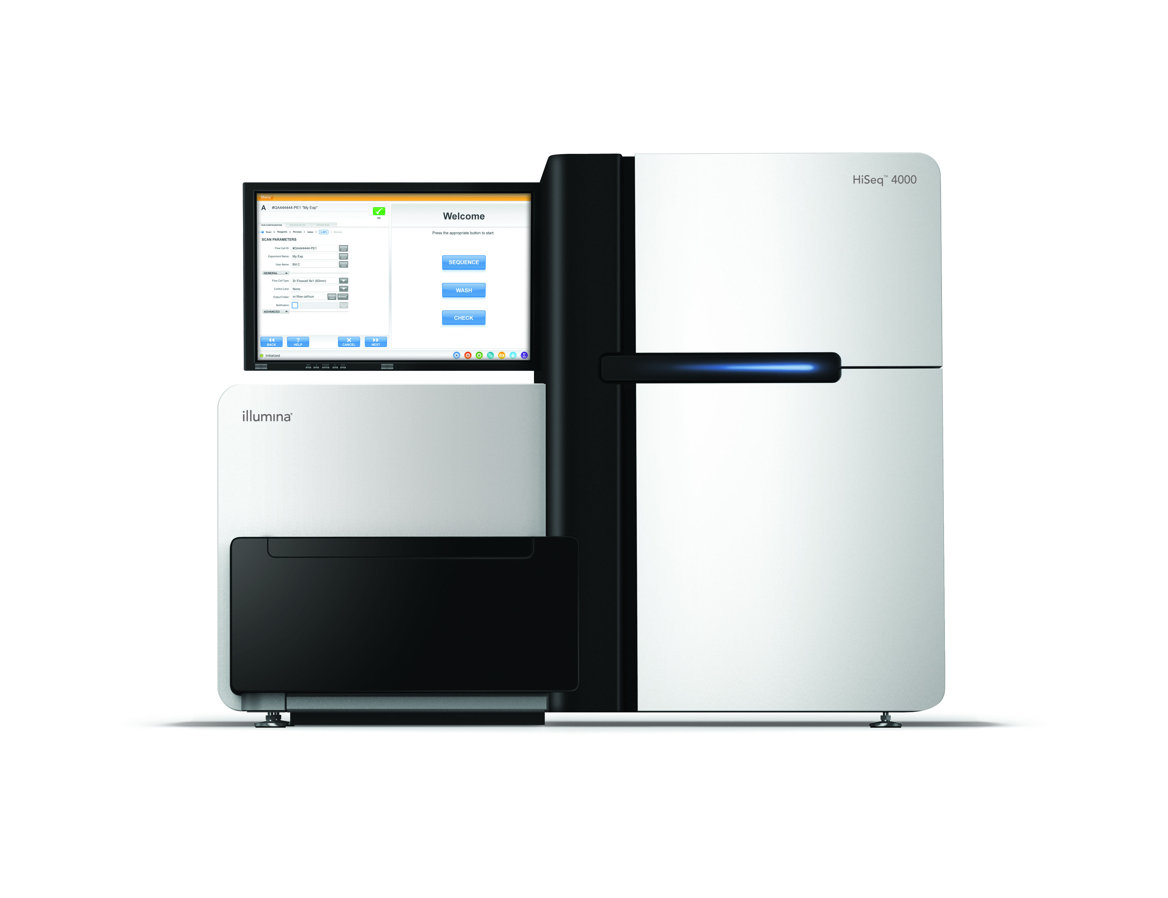
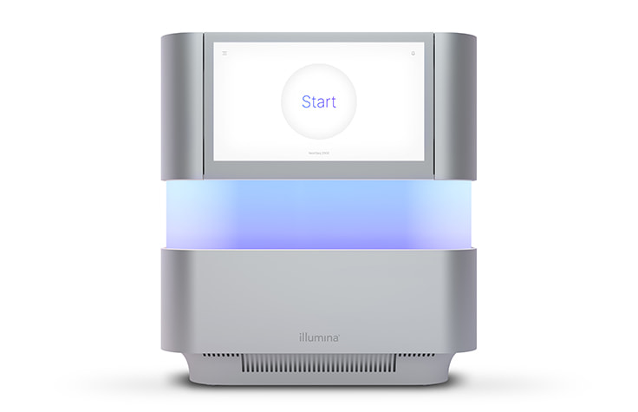
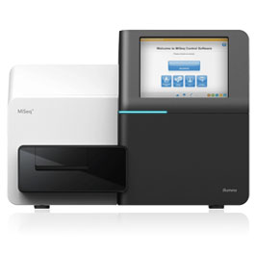
Illumina (solexa) sequencing
Illumina MiSeq, NextSeq 500, Nextseq2000, HiSeq4000 & NovaSeq 6000

Slide 36
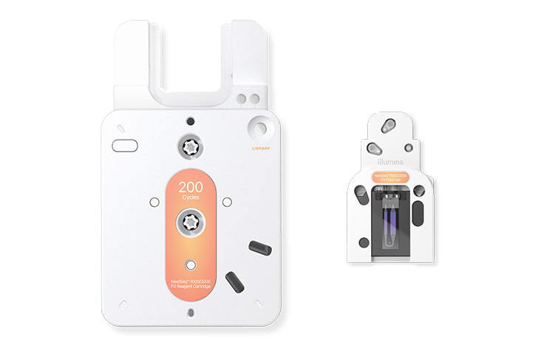
Illumina flowcells
SP
MiSeq
NextSeq500
NextSeq2000
NovaSeq
HiSeq4000

Slide 37
NGS Library Prep
P5
P7

Slide 38
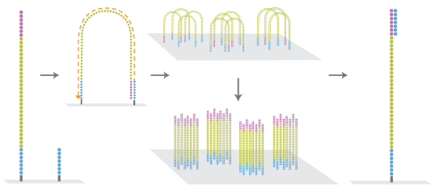
NGS Illumina Clustering
Clonal Amplification
Parallel sequencing
Sample prep

Slide 39
Clonal Amplification
Parallel sequencing
Sample prep

Slide 40
Clonal Amplification
Parallel sequencing
Sample prep

Slide 41
Clonal Amplification
Parallel sequencing
Sample prep

Slide 42
Clonal Amplification
Parallel sequencing
Sample prep

Slide 43
Clonal Amplification
Parallel sequencing
Sample prep

Slide 44
Clonal Amplification
Parallel sequencing
Sample prep

Slide 45
Clonal Amplification
Parallel sequencing
Sample prep

Slide 46
Clonal Amplification
Parallel sequencing
Sample prep

Slide 47
Clonal Amplification
Parallel sequencing
Sample prep

Slide 48
Clonal Amplification
Parallel sequencing
Sample prep

Slide 49
Clonal Amplification
Parallel sequencing
Sample prep

Slide 50
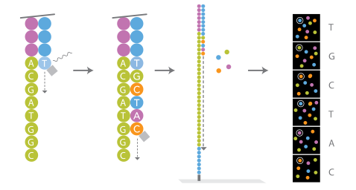
NGS Illumina Sequencing
Sequencing By Synthesis (SBS)

Slide 51
NGS Illumina Sequencing
Imaging MiSeq, HiSeq4000

Slide 52
NGS Illumina Sequencing
Imaging NextSeq500, Nextseq2000* NovaSeq

Slide 53
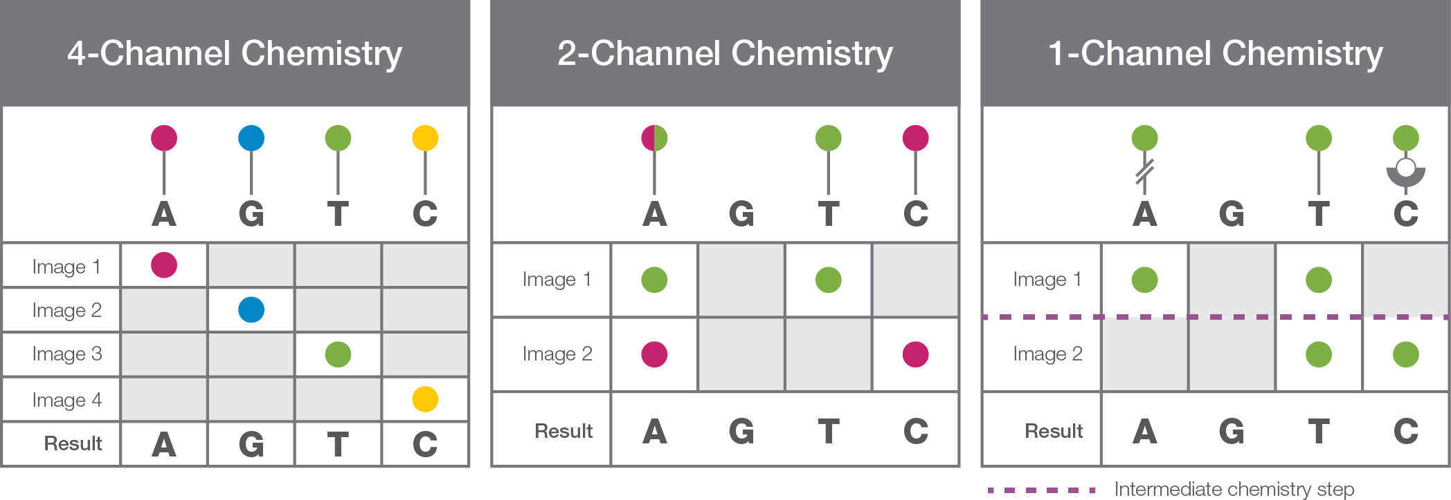
NGS Illumina Sequencing
Different SBS dyes

Slide 54
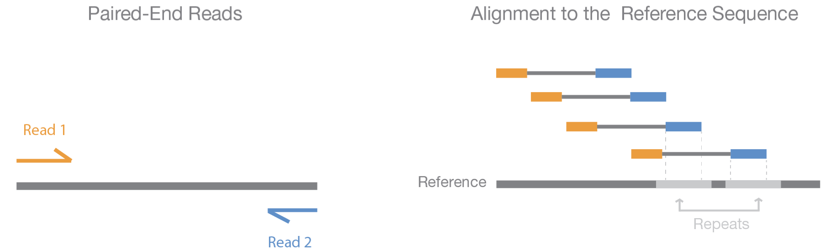
NGS Illumina Sequencing
Paired-end sequencing

Slide 55
Illumina sequencing QC

Slide 56
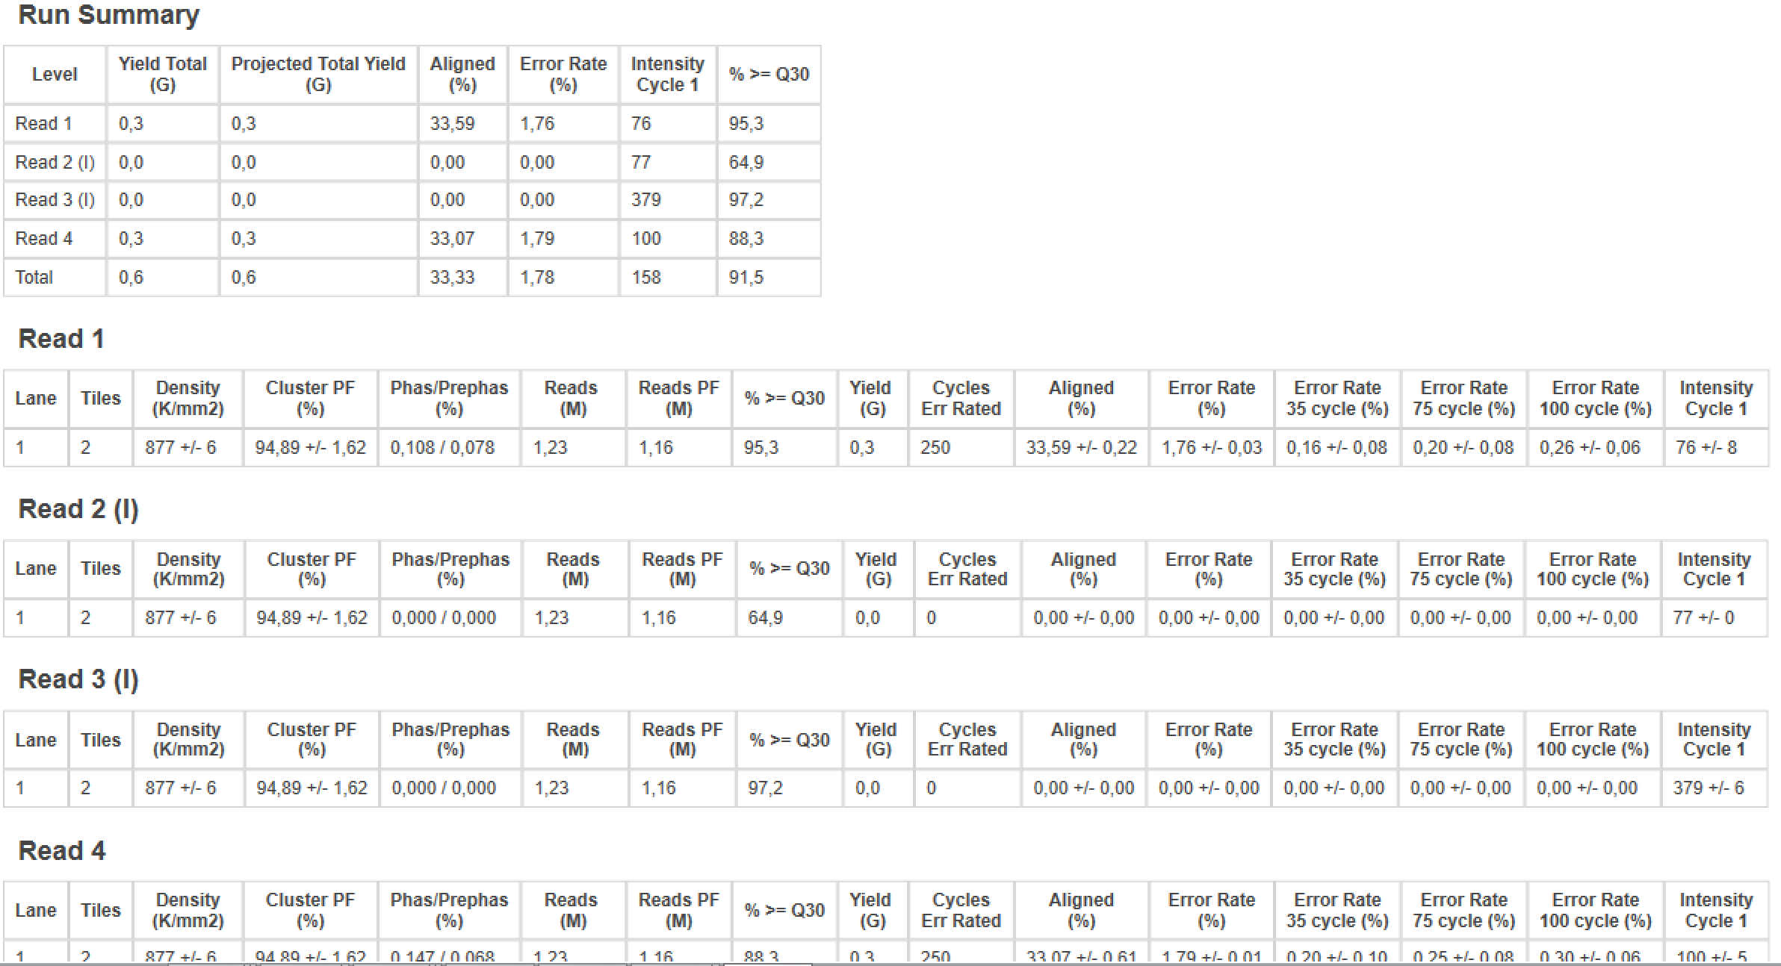
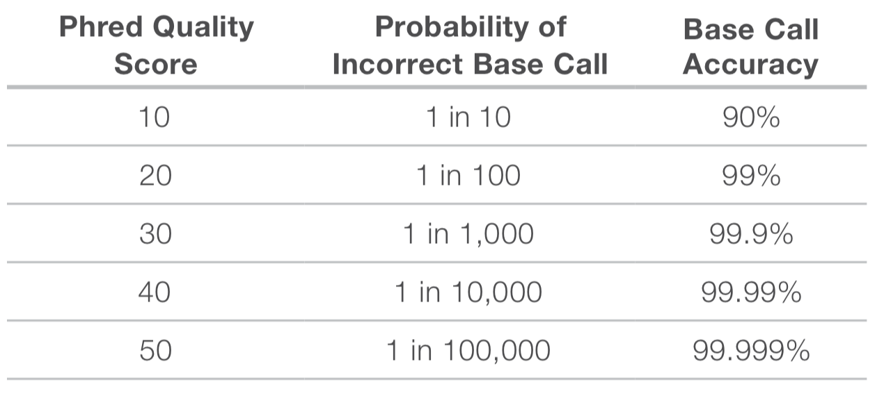
Quality Control

Slide 57
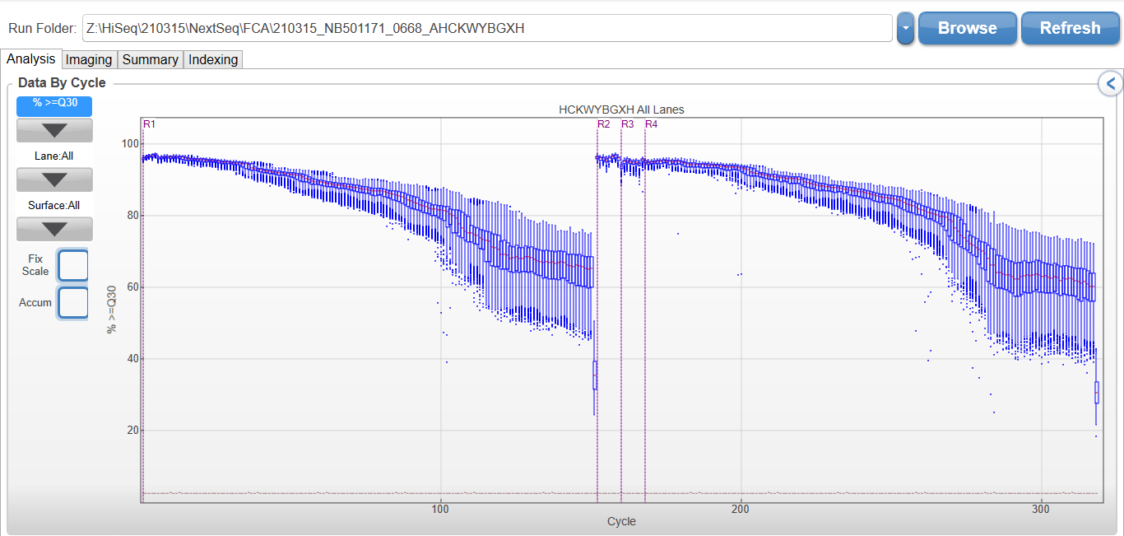
Q30 by cycle

Slide 58
NGS Illumina Sequencing
Quality Control

Slide 59
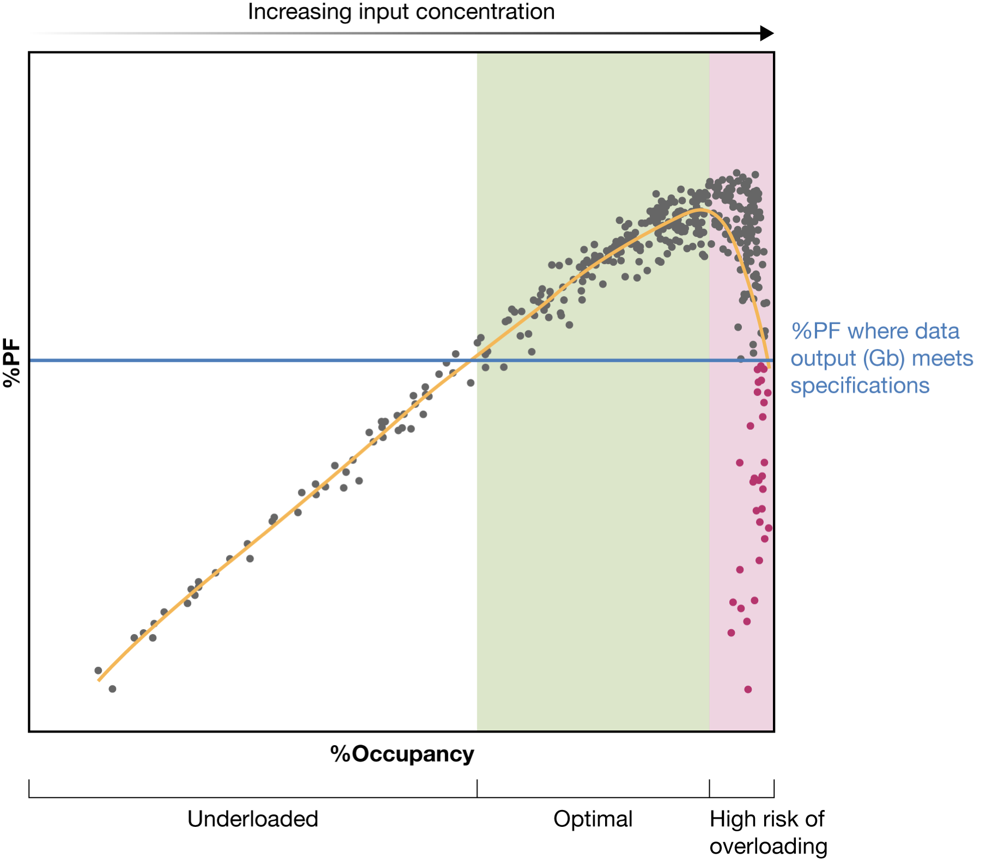
Optimal loading

Slide 60
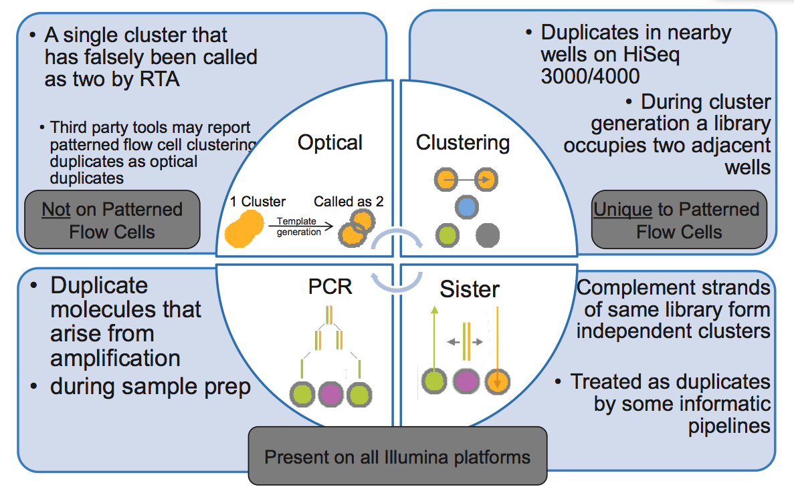
Duplicates
Clonal Amplification
Parallel sequencing
Sample prep

Slide 61
Common loss in Illumina
Insufficient coverage: suboptimal loading
Low complexity library
Overloading
Repeats
Duplicates
Too short fragment size
Overlap
High % adapter
Low Q30

Slide 62
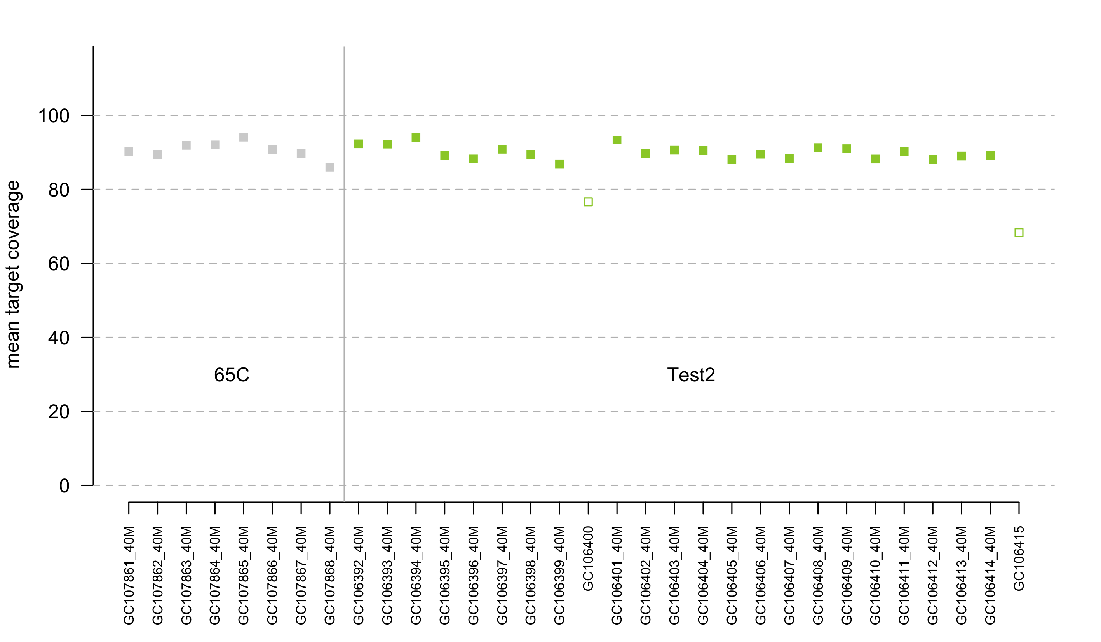
Metrics Picard – coverage technical target

Slide 63
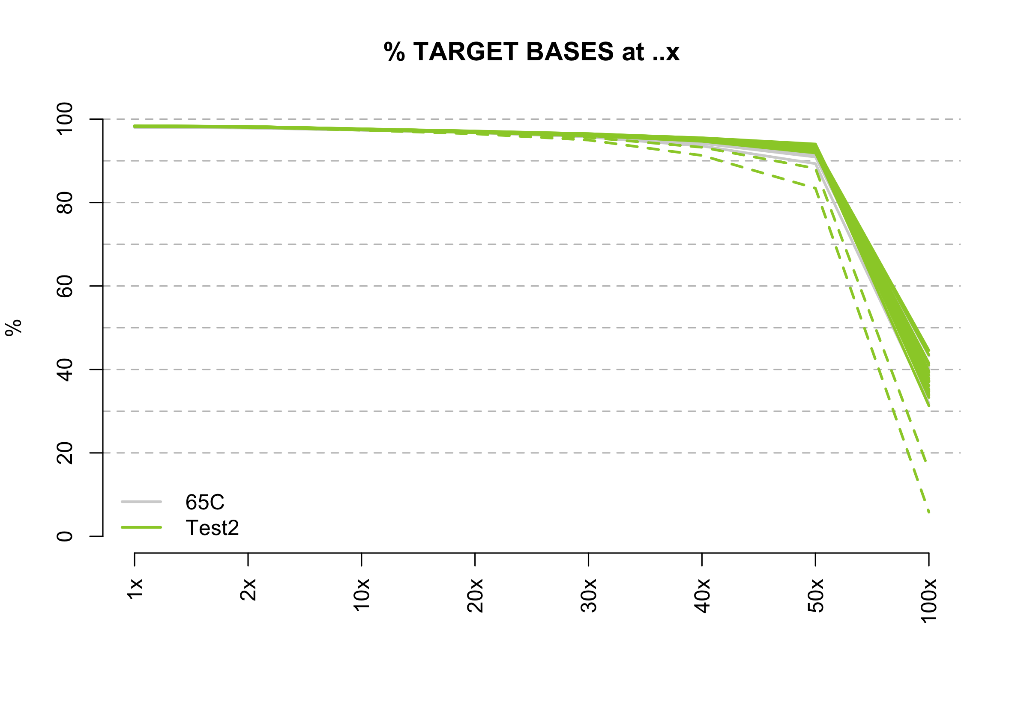
Metrics Picard – uniformity

Slide 64
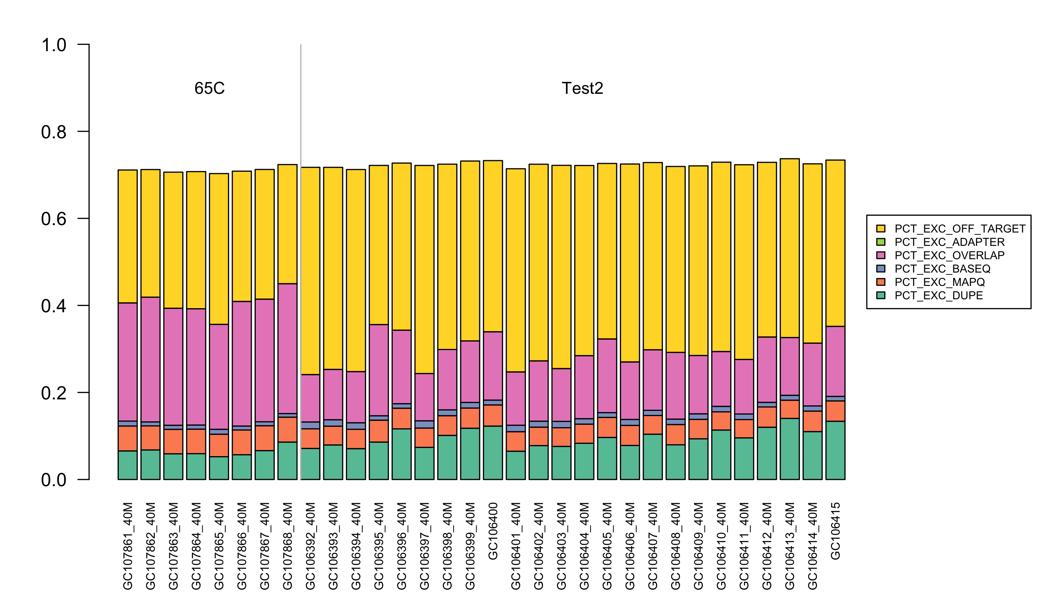
Metrics Picard – Excluded bases

Slide 65
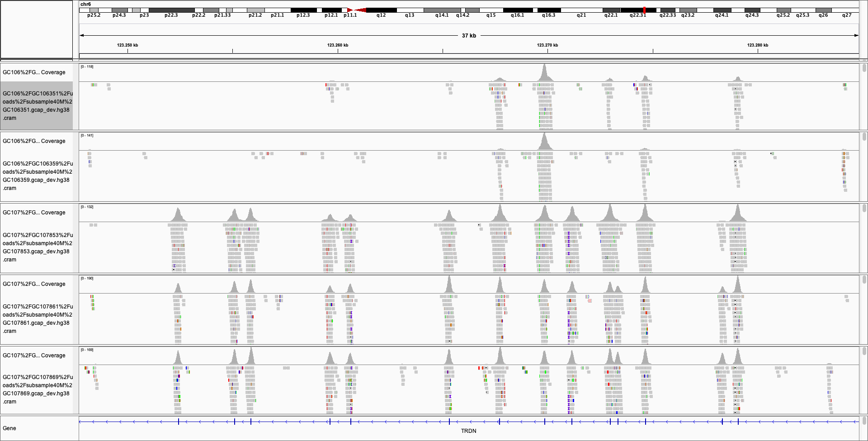
IGV screenshot of part of TRDN (chr6:123,247,689-123,284,977)
TRDN
GC106351
70°C – 1h hyb
GC106359
70°C – 30’ hyb
GC107853
67.5°C – 1h hyb
GC107861
65°C – 1h hyb
GC107869
62.5°C – 1h hyb
chr6:123,247,688-123,284,977
ex26

Slide 66
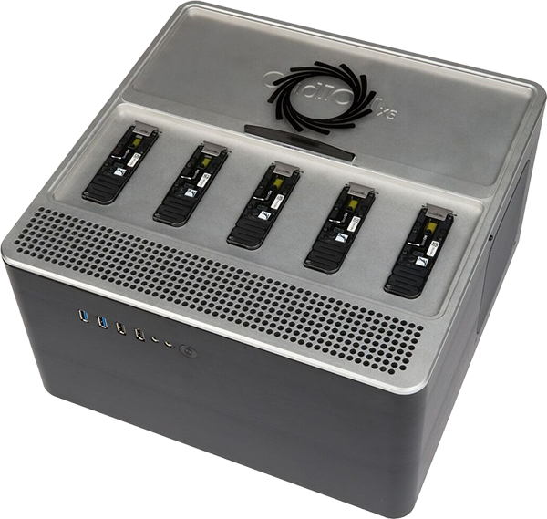
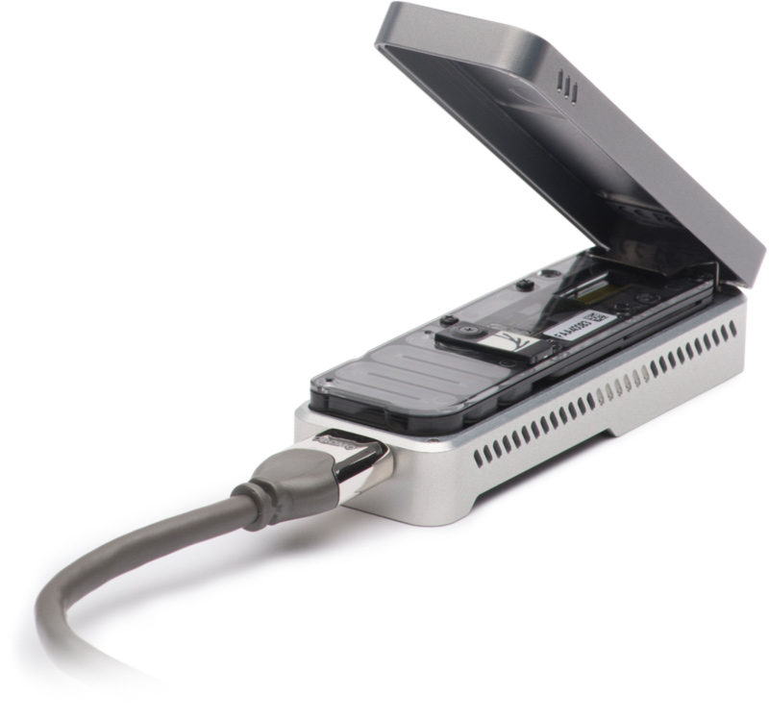
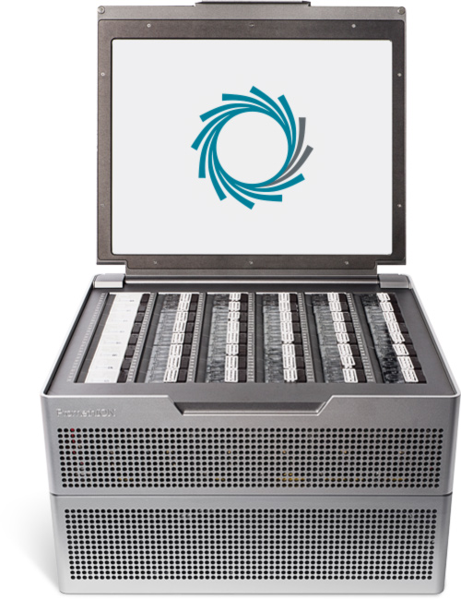
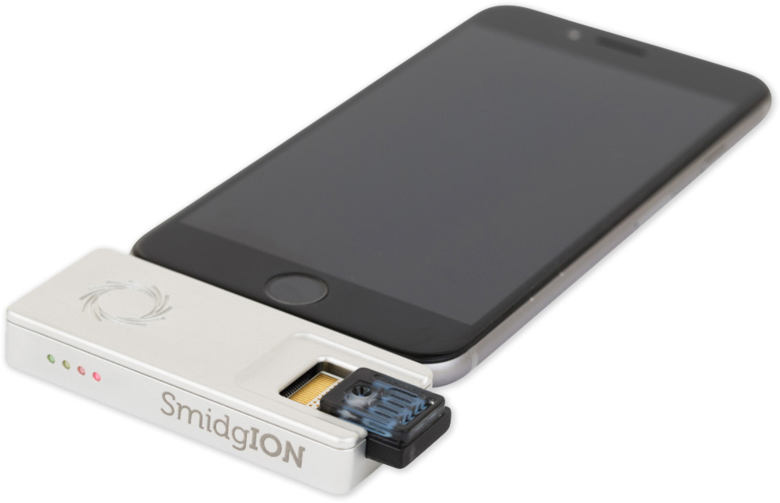
Nanopore sequencing
MinION
GridION
PromethIOM
SmidgION

Slide 67

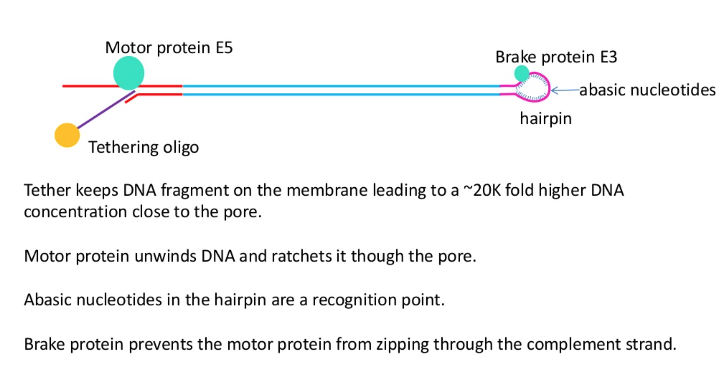
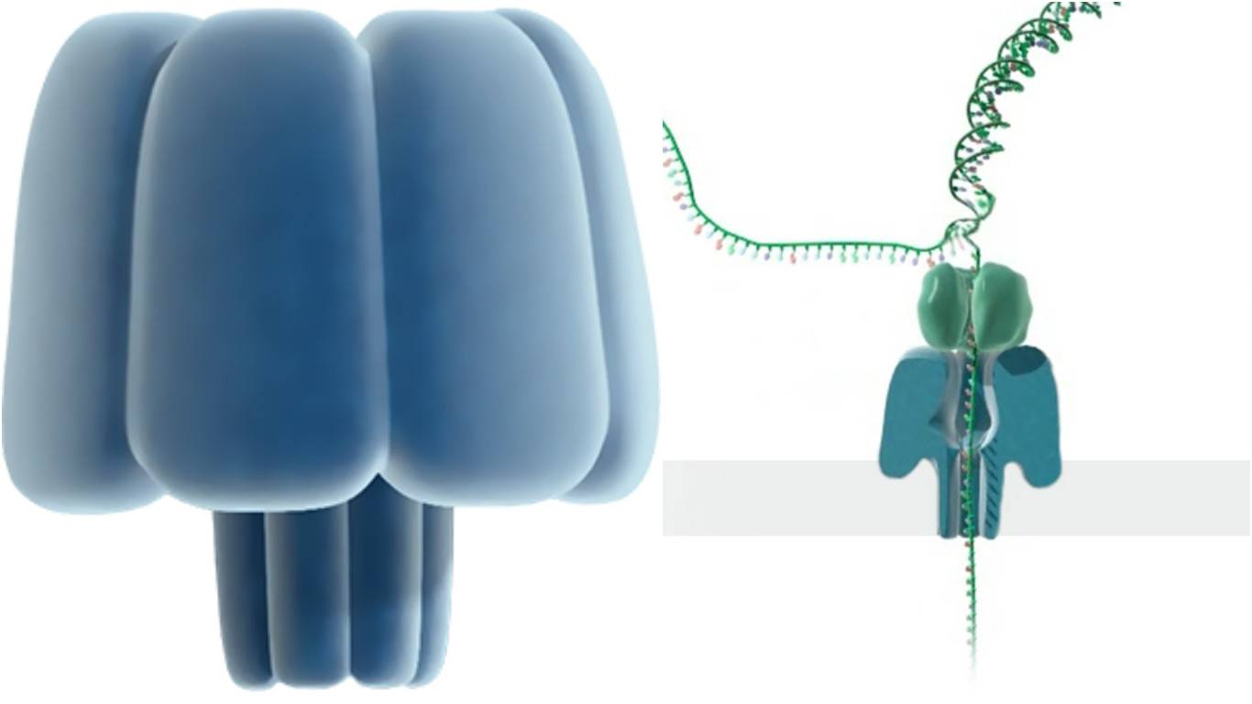
Oxford Nanopore sequencing

Slide 68
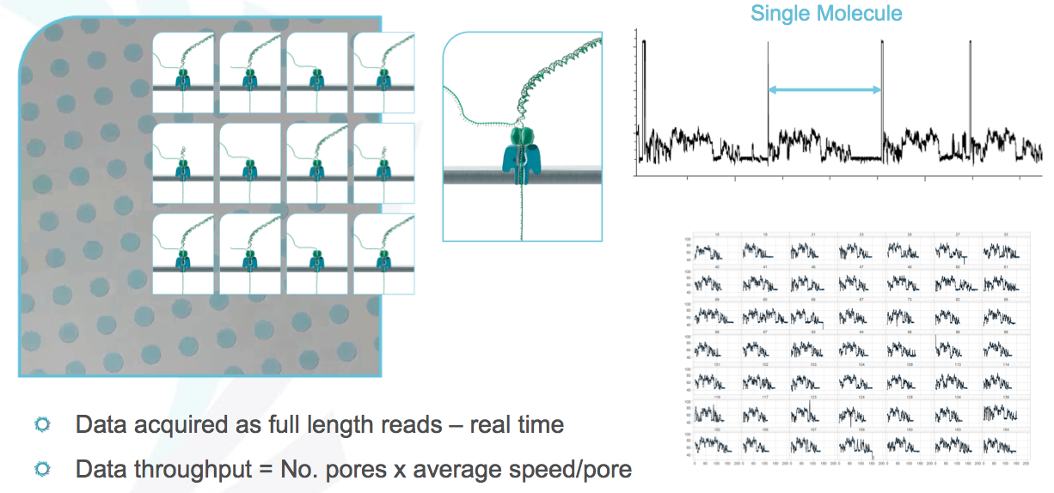

Slide 69
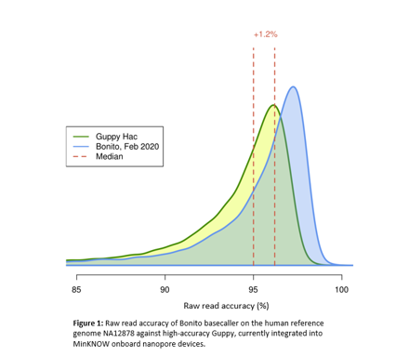
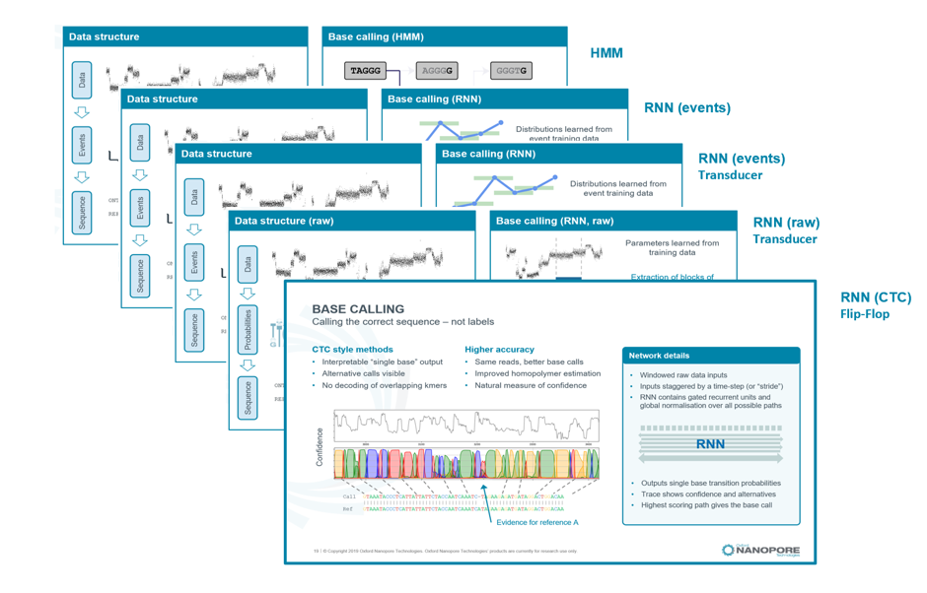
From squiggles to sequencing
New basecaller: extract more correct information from squiggles
Training of base caller for methylation data

Slide 70
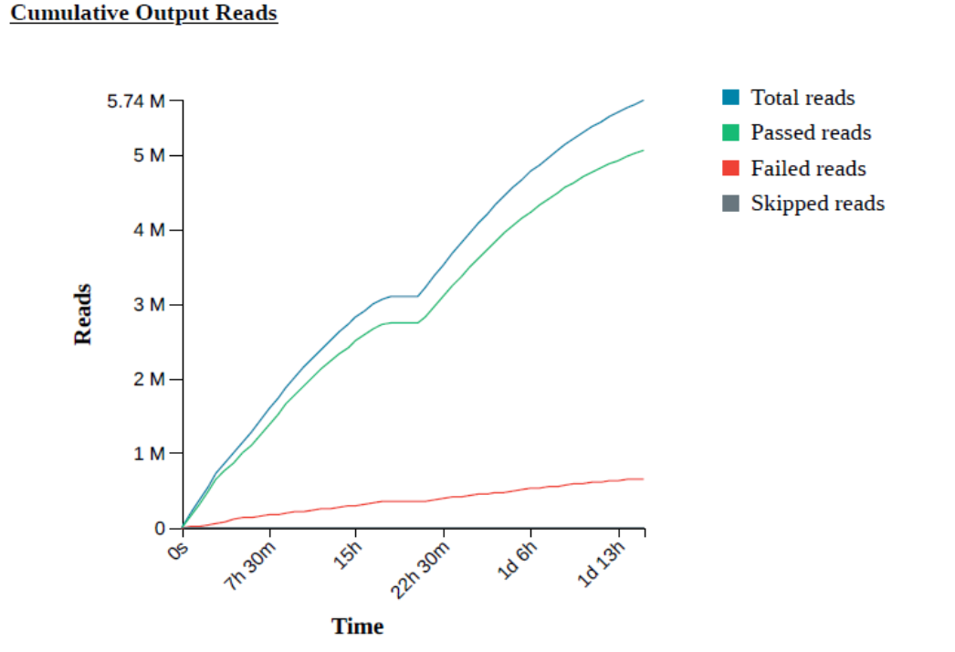
Run QC on Nanopore
Every flowcell is different
Nuclease wash (and refueling) increases output

Slide 71
Translocation speed and pore status

Slide 72
Run QC on Nanopore
Q-score need to be stable
New flowcell chemisty improves Q-score
Barcode selection → select high quality door

Slide 73


SMRT Sequencing
Pacific Biosciences PacBio Sequel IIe

Slide 74

SMRT® Technology
Notes:
ZMW
SMRT Cell is one cornerstone of PacBio’s sequencing platform.
One of several key innovations that makes SMRT Sequencing possible
Each SMRT Cell is comprised of thousands of ZMWs
ZMW arrays are fabricated via standard wafer manufacturing processes
Lithography on a glass substrate
The ZMW provides the smallest detection volume in the world, effectively creating an array the worlds most powerful microscope
A ZMW works via same principle as metallic microwave oven door screen
Light wavelength >> ZMW diameter: it cannot pass through
Only a very small volume at the bottom of each ZMW is illuminated
The volume illuminated is so small enough to encapsulate enable real-time observation of biological events such as DNA synthesis, at the single molecule level
Offers an elegant solution to an extremely complex problem
Before sequencing begins, a process called immobilization binds the DNA template-polymerase complex to the bottom of the ZMW
Immobilization is fully automated and takes place entirely on the instrument
The polymerase is fixed while the DNA template processes during synthesis
Each ZMW can contain one DNA synthesis reaction.
ZMWs are multiplexed into an array to create SMRT Cells, which allow thousands of synthesis reactions to occur simultaneously.
Sequencing
SMRT Sequencing brings together three key PacBio innovations, making it possible to eavesdrop on the natural process of DNA replication
SMRT Cell
Phospholinked nucleotides
PacBio RS instrument
PacBio’s platform automates the immobilization process as part of the preparation for sequencing.
Phospholinked nucleotides are then introduced into the ZMW.
Phospholinked nucleotides are second key to PacBio innovation that enable SMRT sequencing.
Each of 4 nucleotides in is labeled with a different fluorophore.
As a base is incorporated, the corresponding fluorophore emits a pulse of light
Single photon detection cameras inside the PacBio RS are able to detect the emitted flashes
The emitted flashes are processed by optimized algorithms to determine which base is bring incorporated.
The genius of phospholinked nucleotides is that the fluorophore is cleaved and floats from the detection volume
Therefore, no evidence of labeling remains in the detection volume after incorporation
This process occurs simultaneously in literally thousands of ZMWs, each of which can contain a different strand of DNA sample
SMRT Cells are packaged into strips of 8 called 8Pacs
Up to 12 8Pacs may be loaded into a SMRT cell tray at once
One or all SMRT Cells can be used at a time
(Once removed from their sealed bag, an 8Pac has a lifetime of about 1 week)

Slide 75

Template preparation
Template Preparation
Template Preparation
Run Design
Run Design
Polymerase Binding
Polymerase Binding
Instrument Run
Instrument Run
Primary Analysis
Primary Analysis
Secondary Analysis
Secondary Analysis
Tertiary Analysis
Tertiary Analysis
DNA Sample
Fragment DNA
Damage Repair/ End Repair
Ligate adapters
from 250 bp to 400 kb
sequences of both forward and reverse strands in the same trace
Purify DNA
Notes:
The PacBio template preparation creates a structurally linear and topologically circular template. The SMRTbell Template can be used with a variety of sequencing protocols. A single streamlined protocol is used to create libraries of various insert sizes from 200 bp to 20,000 bp depending on the needs of the application. There is no need for routine amplification and only 500 ng of sample is required for libraries of 1 kb or smaller. Suitable sample types include: purified genomic DNA, BACs, cDNA libraries, and PCR products. The SMRTbell libraries are stable, and may be stored for up to six months after preparation.

Slide 76




Universal SMRTbell™ Template
Large Insert Sizes
Generates one pass on each molecule sequenced
Recommended Insert Size: > 3 kb
Maximum length over 300 kb
Circular Consensus Sequencing (CCS)
Small Insert Sizes
Recommended Insert Size: 500 bp-20kb
Generates multiple passes on each molecule sequenced
Notes:
The SMRTbell template format can be used for standard continuous long reads and circular consensus sequencing. For standard sequencing, each SMRTbell template generates one pass on each molecule sequenced. At the other extreme, for smaller insert sizes the SMRTbell template allows multiple reads to be generated on each molecule. These can be combined together to generate a consensus read for each template.

Slide 77

SMRT® Sequencing Accuracy
Notes:
SMRT® Sequencing provides greater than 99.999% (QV 50) accurate sequencing results for resequencing and de novo applications
independent of sequence context or GC content
Evaluation of any sequencing technology has three aspects (single-pass error not among those):
Consensus
Errors are random
No systematic errors
Sequence context bias
Negligible sequence context bias (high AT, high GC, repeat sequences, palindromes)
Mappability of sequence reads
Longest reads means highest quality genomes
Best mapping into repetitive regions
SMRT Sequencing has excellent performance in all three areas
Specific strains: E. coli K12, R. palustris, S. aureus USA300/TCH1516
Star represents point at which PacBio® reads aligned to reference with Quiver show perfect concordance with known reference. These would be 100% accurate, but QV score will ultimately be limited by genome size.
- E. coli has 0 variants compared to reference starting at 80X coverage
- S. aureus has 0 variants compared to reference starting at 60X coverage
- R. palustris still has 5 differences from the reference at 100X coverage. These may or may not be real errors.

Slide 78
Benefits of SMRT® Sequencing
Produce reads with average lengths of 6000 to 10000, with longest reads over 175,000 base pairs
Greater than 99.999% (QV 50) accurate sequencing results
Sensitivity to detect minor variants at frequency less than 0.1%
Detect broad spectrum of base modification events in the same sequencing run that reads canonical base sequence
No amplification bias and least GC bias for improved coverage uniformity
Notes:
Extraordinarily long reads: Produce reads with average lengths of 3,000 to 5,000 bp, with the longest reads over 20,000 base pairs.
Extremely high accuracy: Perform de novo assembly of genomes and detect variants with greater than 99.999% accuracy. Sequence individual molecules with 99% accuracy at greater than Sanger lengths.
Exquisite sensitivity: Detect minor variants that are present at a frequency less than 0.1%.
For research in epigenetics and methylation, the PacBio RS is the only commercially available system that can:
Discover a broad spectrum of DNA base modifications: Go beyond 5-methylcytosine and detect N6-methyladenine, N4-methylcytosine, DNA oxidative damage and other modified bases in the same sequencing run that reads the canonical base sequence.
Additionally, the PacBio RS offers:
Shortest run time: Sequence for as little as 30 minutes and still get reads longer than Sanger sequencing.
Least GC bias: Sequence through regions of extremely high or low GC content with ease, resulting in more even coverage.
No amplification bias: Samples need not be amplified, improving coverage uniformity and avoiding artifacts.

Slide 79

MGI and Aviti Element
MGI: SBS
AVITI: avidite binding

Slide 80


